Slide 1

Algorithm Analysis IT-2101 Lecture - 10
Dr. Mohammad Abu Yousuf
yousuf@juniv.edu

Slide 2
Graph Algorithms Minimum Spanning Trees

Slide 3
Minimum Spanning Trees

Slide 4
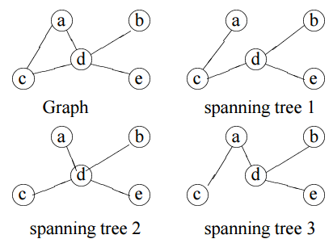
MST
Spanning Trees: A subgraph of a undirected graph G=(V,E) is a spanning tree of G if it is a tree and contains every vertex of G.

Slide 5
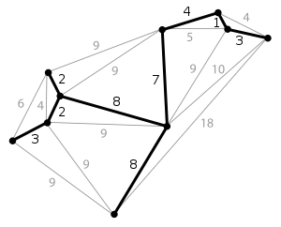

MST
A minimum spanning tree (MST) or minimum weight spanning tree is a subset of the edges of a connected, edge-weighted undirected graph that connects all the vertices together, without any cycles and with the minimum possible total edge weight. That is, it is a spanning tree whose sum of edge weights is as small as possible.
w(T) should be minimized to create a MST

Slide 6
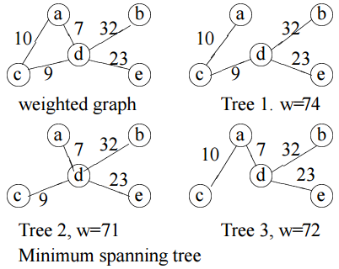
MST
A Minimum Spanning Tree in an undirected connected weighted graph is a spanning tree of minimum weight (among all spanning trees). There are (V-1) edges in the spanning tree.

Slide 7
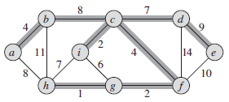
MST
A minimum spanning tree for a connected graph. The weights on edges are shown, and the edges in a minimum spanning tree are shaded. The total weight of the tree shown is 37. This minimum spanning tree is not unique: removing the edge (b, c) and replacing it with the edge (a, h) yields another spanning tree with weight 37.

Slide 8
Algorithms for MST
Prim's algorithm and Kruskal's algorithm to find minimum cost spanning tree uses the greedy approach.

Slide 9
Kruskal’s algorithm To Find MST
Kruskal’s algorithm finds a safe edge to add to the growing forest by finding, of all the edges that connect any two trees in the forest, an edge (u,v) of least weight.
Kruskal’s algorithm qualifies as a greedy algorithm because at each step it adds to the forest an edge of least possible weight.

Slide 10
Kruskal’s algorithm To Find MST
Below are the steps for finding MST using Kruskal’s algorithm:
1. Sort all the edges in non-decreasing order of their weight.
2. Pick the smallest edge. Check if it forms a cycle with the spanning tree formed so far. If cycle is not formed, include this edge. Else, discard it.
3. Repeat step#2 until there are (V-1) edges in the spanning tree.

Slide 11
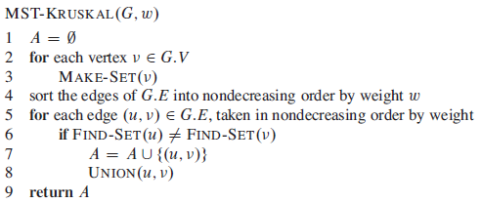
Kruskal’s algorithm To Find MST
The operation FIND-SET(u) returns a representative element from the set that contains u. Thus, we can determine whether two vertices u and belong to the same tree by testing whether FIND-SET(u) equals FIND-SET(v) .
To combine trees, Kruskal’s algorithm calls the UNION procedure.

Slide 12
Kruskal’s algorithm To Find MST
Lines 1–3 initialize the set A to the empty set and create |V | trees, one containing each vertex.
The for loop in lines 5–8 examines edges in order of weight, from lowest to highest.
The loop checks, for each edge (u,v) whether the endpoints u and v belong to the same tree. If they do, then the edge (u,v) cannot be added to the forest without creating a cycle, and the edge is discarded.
Otherwise, the two vertices belong to different trees. In this case, line 7 adds the edge (u,v) to A, and line 8 merges the vertices in the two trees.

Slide 13
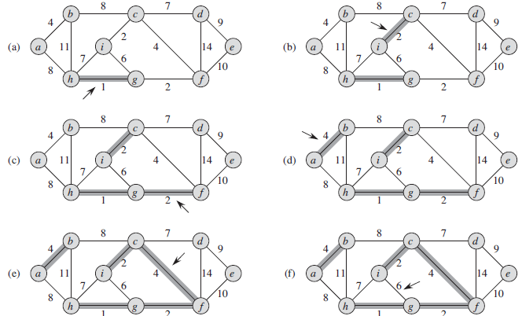
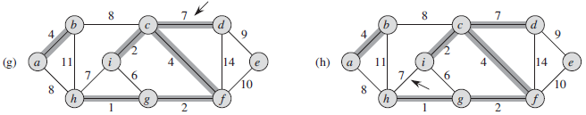
Kruskal’s algorithm To Find MST

Slide 14
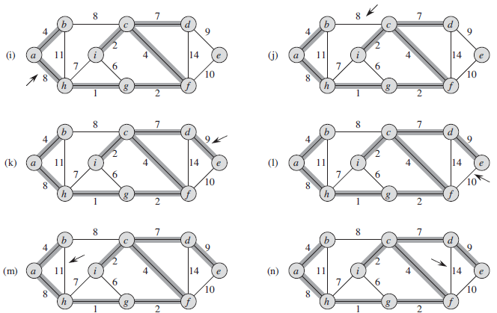
Kruskal’s algorithm To Find MST

Slide 15
Prim’s Algorithm
Prim’s algorithms are greedy algorithm. Each step of a greedy algorithm must make one of several possible choices.
The greedy strategy advocates making the choice that is the best at the moment.
Prim’s algorithm has the property that the edges in the set A always form a single tree.
As Figure shows, the tree starts from an arbitrary root vertex r and grows until the tree spans all the vertices in V .

Slide 16
Prim’s Algorithm
In the algorithm, the connected graph G and the root r of the minimum spanning tree to be grown are inputs to the algorithm. During execution of the algorithm, all vertices that are not in the tree reside in a min-priority queue Q based on a key attribute.
For each vertex v, the attribute v.key is the minimum weight of any edge connecting to a vertex in the tree; by convention, v.key = α if there is no such edge. The attribute v.π names the parent of in the tree.

Slide 17
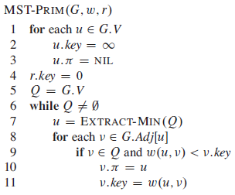
Algorithm

Slide 18
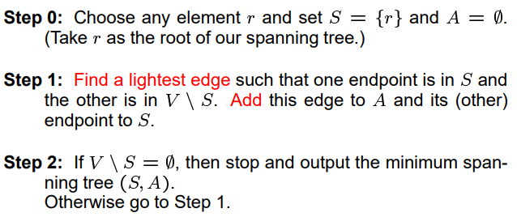
Idea of Prim’s algorithm

Slide 19
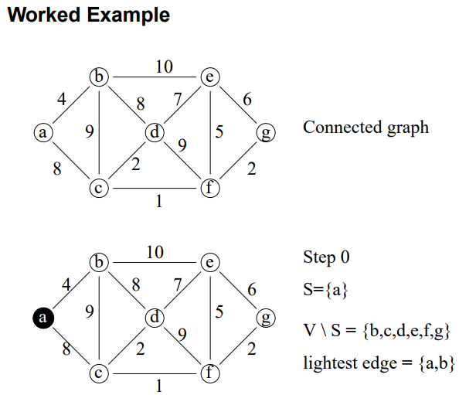
Prim’s Algorithm

Slide 20
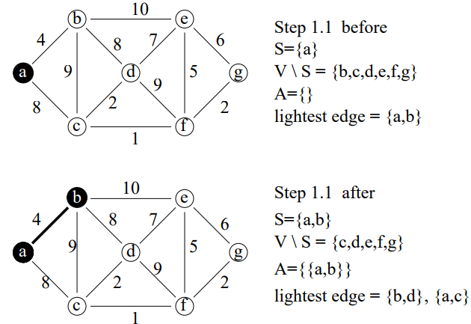
Prim’s Algorithm

Slide 21
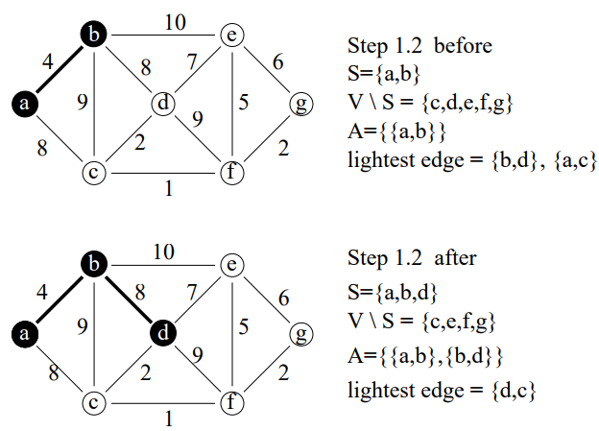
Prim’s Algorithm

Slide 22
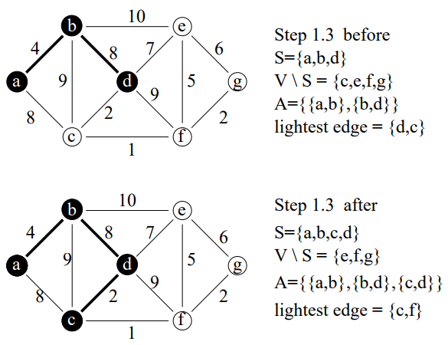
Prim’s Algorithm

Slide 23
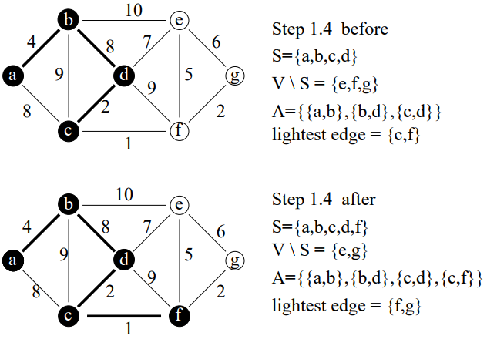
Prim’s Algorithm

Slide 24
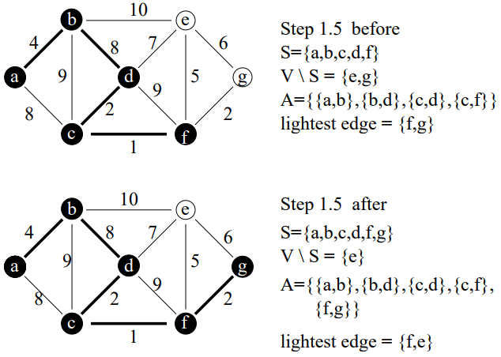
Prim’s Algorithm

Slide 25
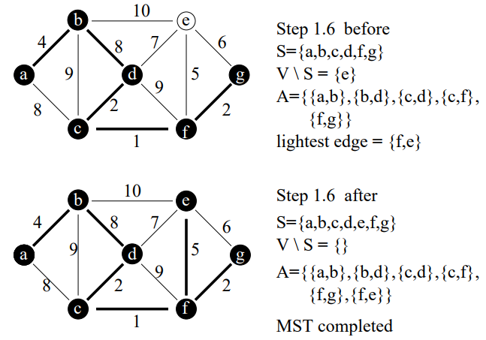
Prim’s Algorithm

Slide 26
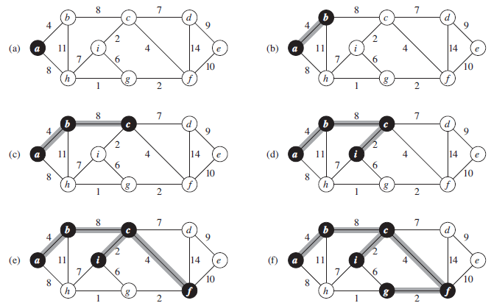
Prim’s Algorithm

Slide 27
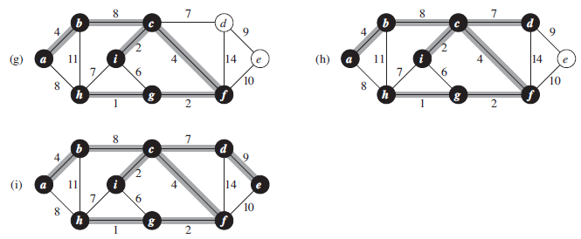
Prim’s Algorithm
The execution of Prim’s algorithm on the graph from Figure, The root vertex is a. Shaded edges are in the tree being grown, and black vertices are in the tree. At each step of the algorithm, the vertices in the tree determine a cut of the graph, and a light edge crossing the cut is added to the tree. In the second step, for example, the algorithm has a choice of adding either edge (b,c) or edge (a,h) to the tree since both are light edges crossing the cut.

Slide 28
Thank you

